Slide 1



ARTIFICIAL
INTELLIGENCE

Slide 4


What is Artificial Intelligence?
Artificial intelligence is the science of making machines that can think like humans.
It is the simulation of human intelligence processes by machines, especially computer systems

Slide 5

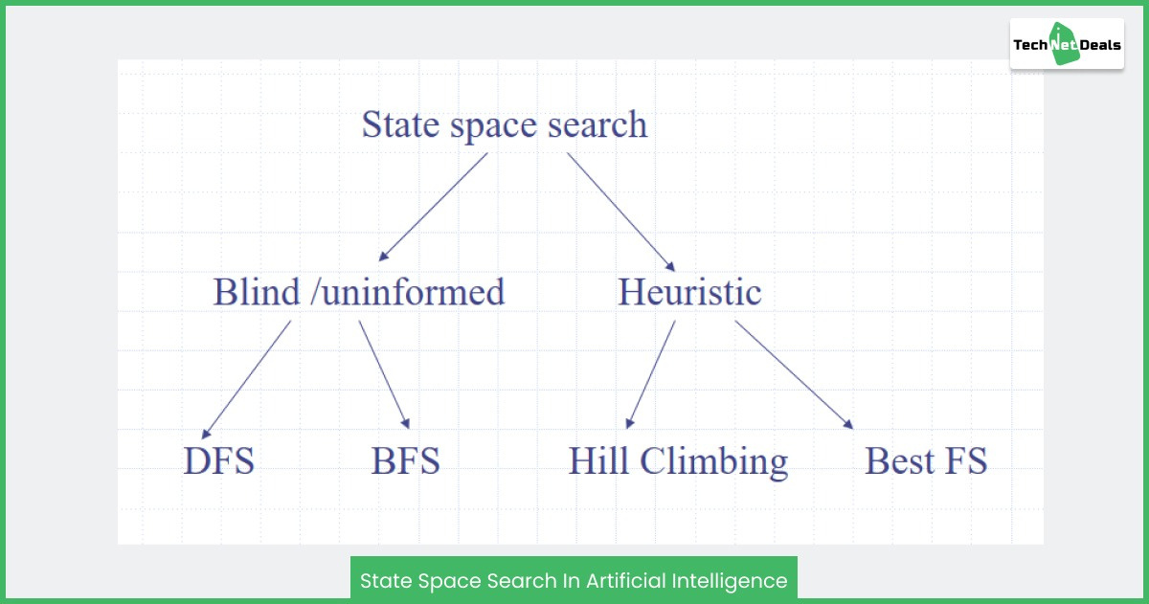

State space search is a problem-solving technique used in artificial intelligence and computer science to explore and navigate through the possible states of a problem in order to find a solution. It involves systematically searching through the states of a problem domain to reach a goal state, starting from an initial state, by applying a sequence of actions ..

Slide 6


It involves defining an INITIAL STATE and a GOAL STATE and then determining a sequence of actions, called states, to follow.
State can be an Initial State, a Goal State, or any other possible state that can be generated by applying rules .
Space refers to the exhaustive collection of all possible states.
Search tree is a tree-like structure that represents the problem. The initial state is represented by the root node of the search tree, which is the starting point of the tree.

Slide 7

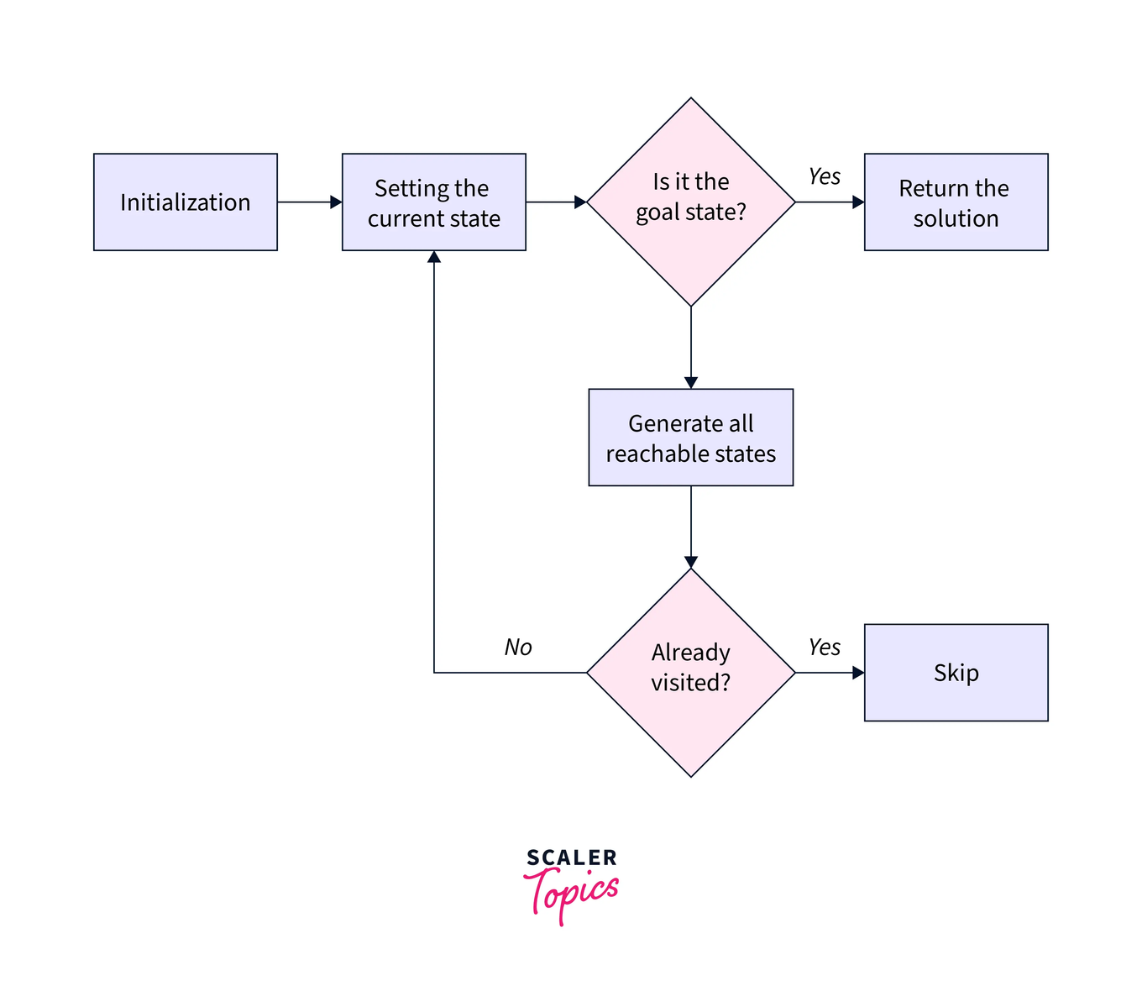
Steps in State Space Search
The steps involved in state space search are as follows :
To begin the search process, we set the current state to the initial state.
2. We then check if the current state is the goal state. If it is, we terminate the algorithm and return the result.
3. If the current state is not the goal state, we generate the set of possible successor states that can be reached from the current state.
4. For each successor state, we check if it has already been visited. If it has, we skip it, else we add it to the queue of states to be visited.
5.
Next, we set the next state in the queue as the current state and check if it's the goal state. If it is, we return the result. If not, we repeat the previous step until we find the goal state or explore all the states.
6. If all possible states have been explored and the goal state still needs to be found, we return with no solution.

Slide 8



We need to reach ANDC from Govindpuri Metro Station
Acharya Narendra Dev College

Slide 9

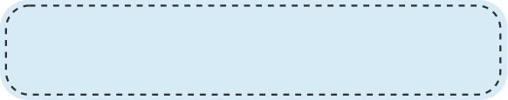
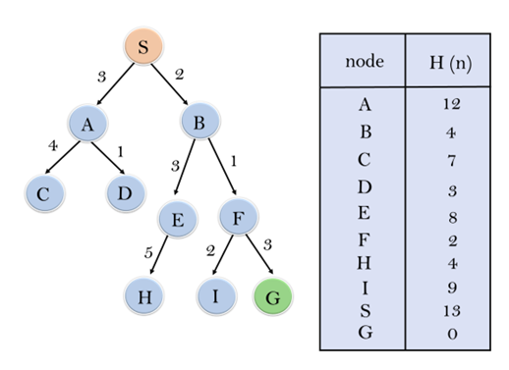


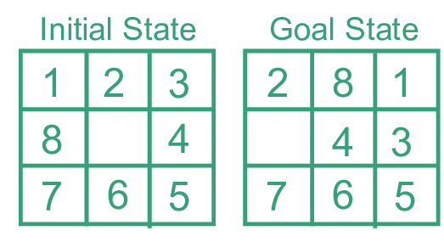
8 - Puzzle Problem :
It is a sliding puzzle game consisting of 8 numbered tiles arranged in a 3x3 grid and one blank space. The game aims to rearrange the tiles from their initial state to a final goal state by sliding them into the blank space.
Example: 8-puzzle
To represent the state space in this problem, we use the nine tiles in the puzzle and their respective positions in the grid. Each state in the state space is represented by a 3x3 array with values ranging from 1 to 8, and the blank space is represented as an empty tile.

Slide 10

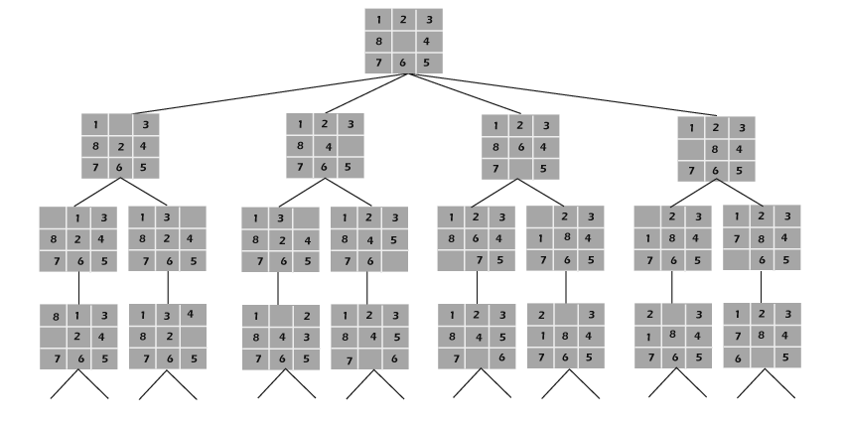
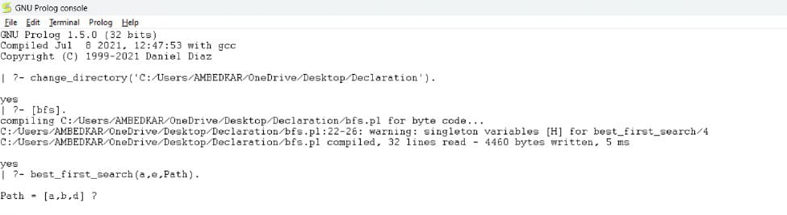
Solution to the 8 Puzzle Problem using Brute Force :

Slide 11
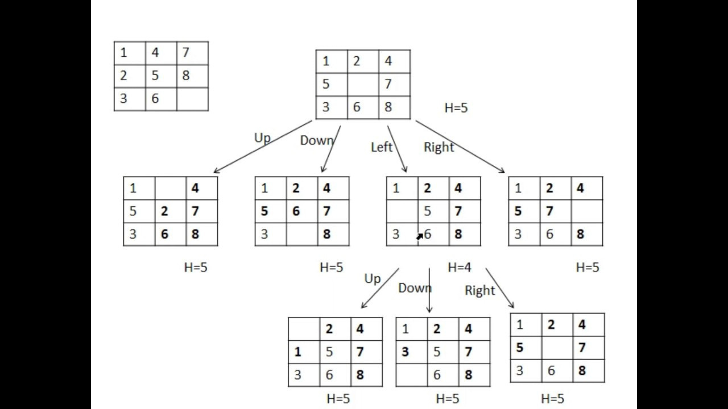
Rules for solving the puzzle :
Instead of moving the tiles in the empty space, we can visualize moving the empty space in place of the tile, basically swapping the tile with the empty space. The empty space can only move in four directions viz.,
1. Up
2.Down
3. Right or
4. Left
f-score = h-score + g-score
A* uses a combination of heuristic value (h-score: how far the goal node is) as well as the g-score (i.e. the number of nodes traversed from the start node to current node).
In our 8-Puzzle problem, we can define the h-score as the number of misplaced tiles by comparing the current state and the goal state or summation of the Manhattan distance between misplaced nodes.
g-score will remain as the number of nodes traversed from a start node to get to the current node.

Slide 12


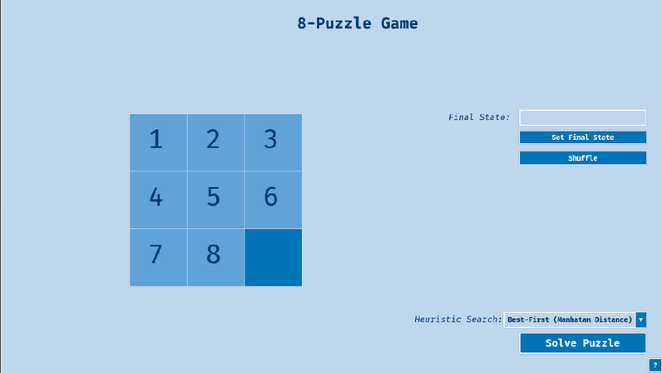
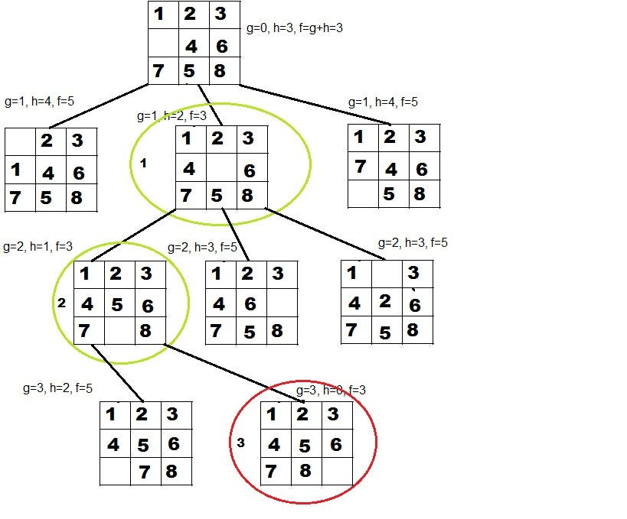
Solution to the 8 Puzzle Problem using A* Algorithm :
GOAL STATE

Slide 13


THANK YOU!

